Slide 1

DriverPass System Analysis
Anthony Petrunt
Notes:
[No speaker notes required for this slide.]

Slide 2

System Requirements
System should be web-based.
System should run fast with upload speed in seconds.
System shall send email when password is forgotten so user can make new one.
System shall update any user information on backend.
Notes:
For functional requirements I chose the system to be web-based and to have upload speed of seconds. This meets DriverPass’ needs of the system running to their expectations. In their requirements both are mentioned of something they want included in the system. For non-functional requirements I chose for the system to send an email when the password is forgotten so user can make a new one and for the system to update and user information on the backend. These are also requirements of DriverPass’ and I feel that they are required to ensure that the system runs to its best potential. After all, DirverPass is an important client and it is my job to ensure that their system runs it’s very best. By ensuring these things it will in turn ensure the system runs to it’s fullest capability.

Slide 3
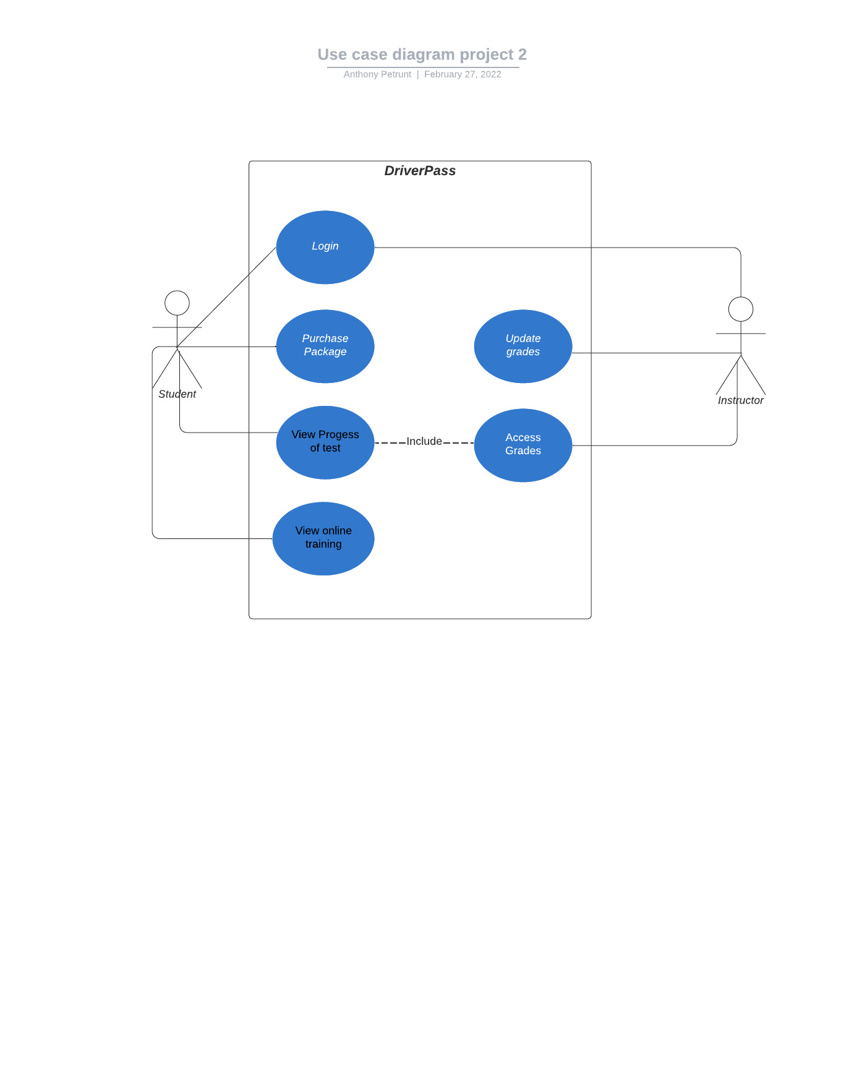
Use Case Diagram
Notes:
The different actors are the student and the instructor. The different use cases include login, purchase package, view progress, and view online training. I decided to keep the diagram very simple. I see a lot of use case diagrams that are very complex and hard to read. I feel that it is always best to keep diagrams as simple as possible so that all parties can understand, especially those not familiar with the diagrams. I ensures that the diagram met DriverPass’s needs by going back to what they asked for and including it in the diagram.

Slide 4
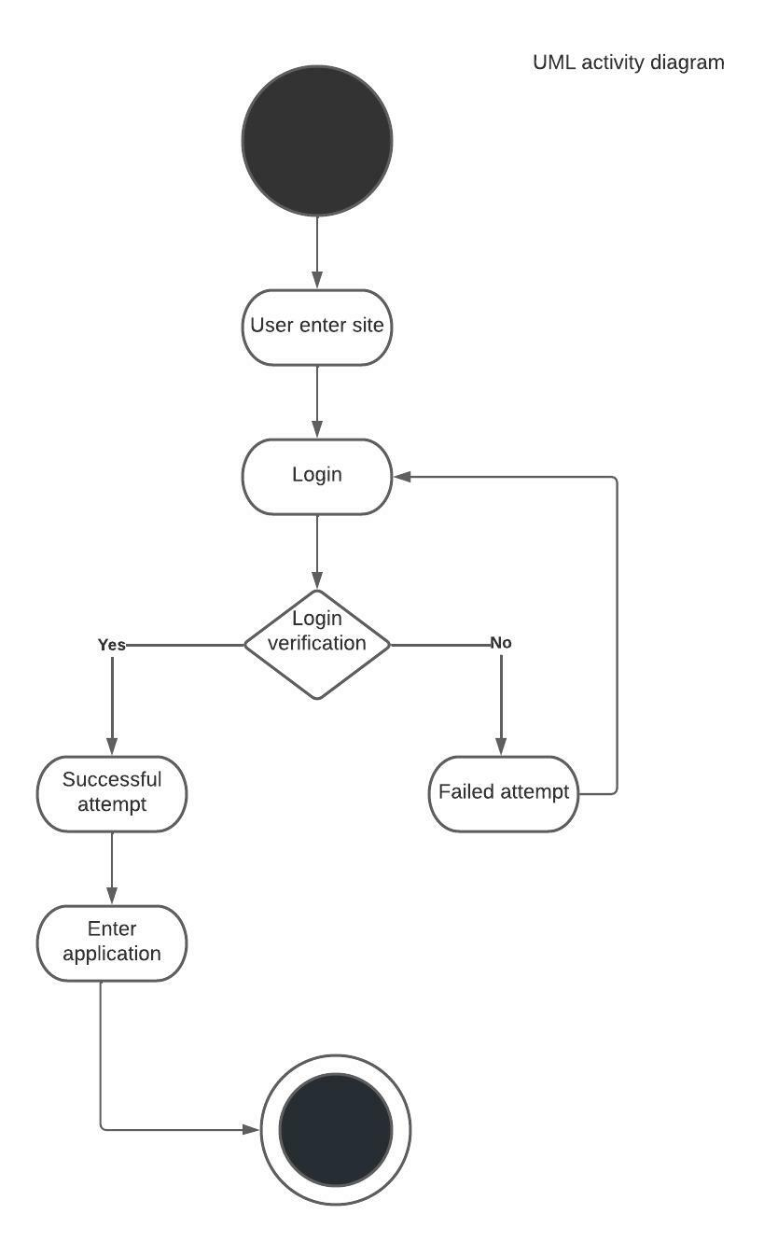
Activity Diagram
Notes:
I am breaking down the process of a user when they login to their account. They first enter the site and login, if the password is incorrect they are prompted to login again, if the password is correct they then can enter the application. Again, I decided to keep this simple as to make sure the audience can understand the process of logging in. I feel this meets DirverPass’s needs as the diagram visually represent what a user can expect while logging into their account.

Slide 5
Security
Username and password are required to login
SSL will ensure secure connection or the data exchange between the client and the server
Two way authentication
Notes:
I ensured security by making sure that the user must enter a correct username and password before entering the site. This is key to ensure that only users who have made account prior and have the correct information can enter the site.

Slide 6
System Limitations
Limited time of 15 weeks
Limited to only the information presented to me to go off
Limited to being at the whim of any changes that the DMV may make
Limited to ability to anticipate any changes made to web browsers
Notes:
One limitation is that of time. With only 15 weeks to create this system, time will be crunched. Also we are limited to only the information presented to me and limited to changes that the DMV may make. Lastly, we are limited to being able to anticipate any changes made to web browsers. These are all key things to take into consideration and I feel I did so in my design. It is always important to make sure that you limit the exposure that any limitation may have in the end.

